Slide 1
Designing Microsoft Azure Infrastructure Solutions
Maruti Makwana
MCT Corporate Trainer
https://www.linkedin.com/in/marutimakwana/
7th July 2025

Slide 2
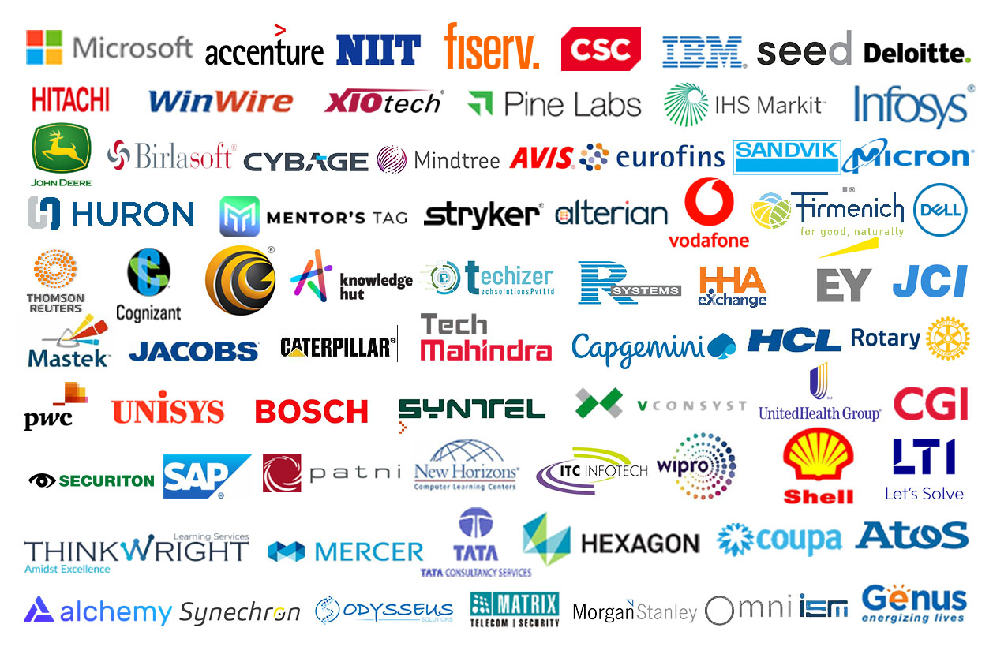
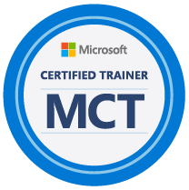
Maruti
Makwana

Slide 3
About this course
Purpose – Azure Architects
Subject matter expertise in designing cloud and hybrid solutions
Expertise includes compute, networking, storage, application services, data solutions, monitoring and security.
Prerequisites
Working knowledge of networking technologies including connectivity services, application delivery services, and network architectures.
Working knowledge of storage technologies including relational and non-relational data solutions.
Working knowledge of compute technologies including virtual machines, containers, and PaaS compute solutions. .
Experience architecting solutions including security, migration, and business continuity.
Notes:
Be sure to ask your students about their level of experience. Have they taken AZ-104 (Admin) or another Microsoft course?
Microsoft Learn has a series of Fundamental modules for Azure, networking, and security. More modules are added every day and can help students ramp up on Azure basics. https://learn.microsoft.com/learn/browse/?term=fundamentals&terms=fundamentals&products=azure

Slide 4
Course schedule
Day 1
Day 2
Day 3
Day 4
Introduction
Storage (non-relational)*
App Architecture*
Networks*
Governance*
Storage (relational)*
Authentication and Authorization*
BCDR
Compute*
Data Integration
Monitoring**
Migrations
* Case study
** Fabrikam Residences case study
Notes:
Adjust this slide to your teaching schedule. A more detailed timing table is provided in the Trainer Prep Guide. The table is just a guideline on how you might schedule your class. If you are running behind, consider using the last daily case study as homework. Also, consider using the Module Review questions to recap the day before or after breaks to refocus the class. Some instructors like to complete the case study then use the lecture material for review. Lecture is estimated at 60 – 90 minutes. Case studies are estimated at 60-120 minutes. There is a Fabrikam case study for Day 3 that brings together the previous content. Modules that do not have a formal case study will have a small decision scenario at the end. Be sure to read more about the case studies in the Instructor Solution Guide.

Slide 5

Get ready for your Microsoft Certification exam
Exam AZ-305: Designing Microsoft Azure Infrastructure Solutions
Understand the skills measured by the exam
Build confidence in your skills
Study area | Percentage
Design identity, governance, and monitoring solutions | 25-30%
Design data storage solutions | 20-25%
Design business continuity solutions | 15-20%
Design infrastructure solutions | 30-35%
Find in the exam page resources to help prepare
Watch exam prep videos
Review the exam study guide
Take a practice assessment
Notes:
Percentages indicate the relative weight of each area on the exam. The higher the percentage, the more questions you are likely to see in that area.
Exam AZ-305: Designing Microsoft Azure Infrastructure Solutions - https://learn.microsoft.com/credentials/certifications/exams/az-305/

Slide 6

Case studies
Tailwind Traders is modernizing its infrastructure and moving to the cloud -
You have been asked to recommend and suggest new cloud architectures - requirements and tasks are provided in case studies
Make sure to actively participate in small groups or individually
Become familiar with the Azure Architecture Center, Azure Charts, and the Azure Documentation.
Consider the Cloud Adoption Framework and Well Architected Framework as you design your case study solutions (next slides)
Optional sandboxes are provided on Learn
Notes:
AZ-305 Case Study GitHub
https://microsoftlearning.github.io/AZ-305-DesigningMicrosoftAzureInfrastructureSolutions/
Be prepared to discuss how students should approach the case studies. How will they participate? Will they be expected to present a solution? What tools are available to them to draw architectures or answer questions?
Use this slide and the next two slides to give students areas to explore and use in class.

Slide 7
AZ-305T00A Designing Microsoft Azure Infrastructure Solutions

Slide 8
Design a governance solution
Notes:
Design governance
https://learn.microsoft.com/training/modules/design-governance/

Slide 9
Learning Objectives
Design for governance
Design for management groups
Design for Azure subscriptions
Design for resource groups
Design for resource tagging
Design for Azure Policy and RBAC
Case study
Learning recap
AZ-305: Design Identity, Governance, and Monitoring Solutions (25-30%)
Design Governance
Recommend a structure for management groups, subscriptions, and resource groups, and a strategy for resource tagging
Recommend a solution for managing compliance
Recommend a solution for identity governance
Notes:
Exam page
https://learn.microsoft.com/learn/certifications/exams/az-305
Prerequisites
Conceptual knowledge of governance policies, resource organization, and subscription management.
Working experience with organizing resources, applying governance policies, and enforcing compliance requirements.

Slide 10
Design for governance

Slide 11
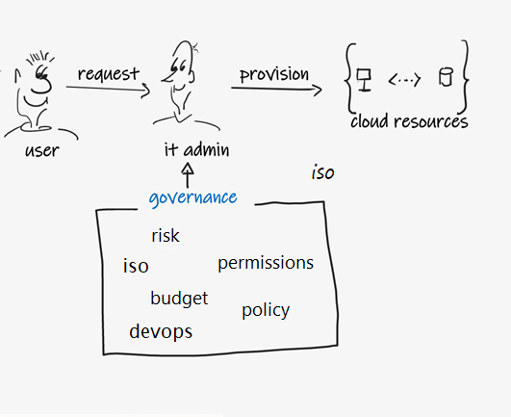
Governance – whiteboard and discussion
Why is governance important?
Who in your company would be concerned about governance?
When should you think about implementing governance?
What could happen if you don’t implement governance?
Notes:
Why is governance important?
https://learn.microsoft.com/azure/cloud-adoption-framework/govern/methodology

Slide 12







Govern resources in Azure
Governance provides mechanisms and processes to maintain control over your applications and resources in Azure.
Tenant root group
Determine your requirements, plan your initiatives, and set strategic priorities
Plan for governance at every level
Management groups
Subscriptions
Resource groups
Resources
Management
groups
Subscriptions
Resource
groups
Resources
Notes:
Azure governance documentation
https://learn.microsoft.com/azure/governance/
Overview of Azure subscriptions, management groups, and resources https://learn.microsoft.com/learn/modules/azure-architecture-fundamentals/overview
Organize your Azure resources effectively
https://learn.microsoft.com/azure/cloud-adoption-framework/ready/azure-setup-guide/organize-resources?tabs=AzureManagementGroupsAndHierarchy
Stay at high level there are slides for item in the hierarchy. Review why governance is important.
Management groups help you manage access, policy, and compliance for multiple subscriptions.
Subscriptions are logical containers that serve as units of management and scale. Subscriptions are also billing boundaries.
Resource groups are logical containers into which Azure resources are deployed and managed.
Resources are instances of services that you create. For example, virtual machines, storage, and SQL databases.

Slide 13
Design for management groups

Slide 14
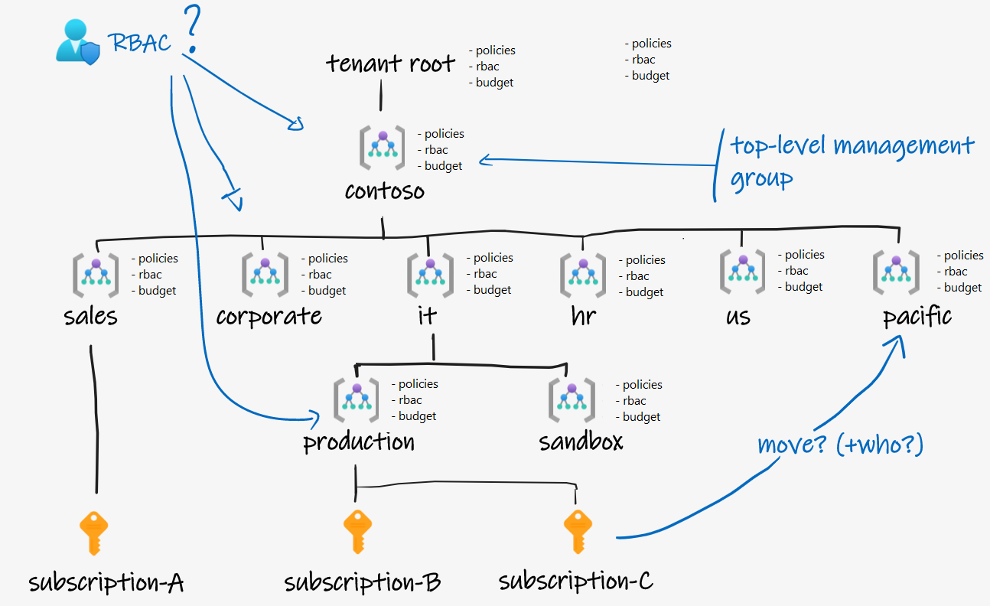
Management groups – whiteboard and discussion (notes)
Notes:
Should you go for a deeply nested hierarchy, or for a reasonably flat one? Why?
How would you organize your management groups? By department/geography/product line/…
https://learn.microsoft.com/azure/cloud-adoption-framework/ready/landing-zone/design-area/resource-org-management-groups
Why should you consider a top-level management group?
https://learn.microsoft.com/learn/modules/design-governance/3-design-for-management-groups
https://learn.microsoft.com/azure/cloud-adoption-framework/ready/landing-zone/design-area/resource-org-management-groups#management-groups-in-the-azure-landing-zone-accelerator
How do you protect your management groups so that not everyone can create/update them? Who can create them? Who can assign a subscription to a management group?
Can I as a subscription owner move my subscription to another management group (and circumvent certain policies)?
https://learn.microsoft.com//azure/governance/management-groups/overview#management-group-access

Slide 15
Plan your management groups
Management groups manage access, policy, and compliance for multiple subscriptions.
Keep the management group hierarchy reasonably flat
Consider a top-level management group
Consider an organizational or departmental structure
Consider a geographical structure
Consider a production management group
Consider a sandbox management group
Consider isolating sensitive information in a separate management group
Tenant root group
Tailwinds
Sales
Corporate
IT
Production
Notes:
What are Azure management groups? https://learn.microsoft.com/azure/governance/management-groups/overview

Slide 16
Design for Azure subscriptions

Slide 17
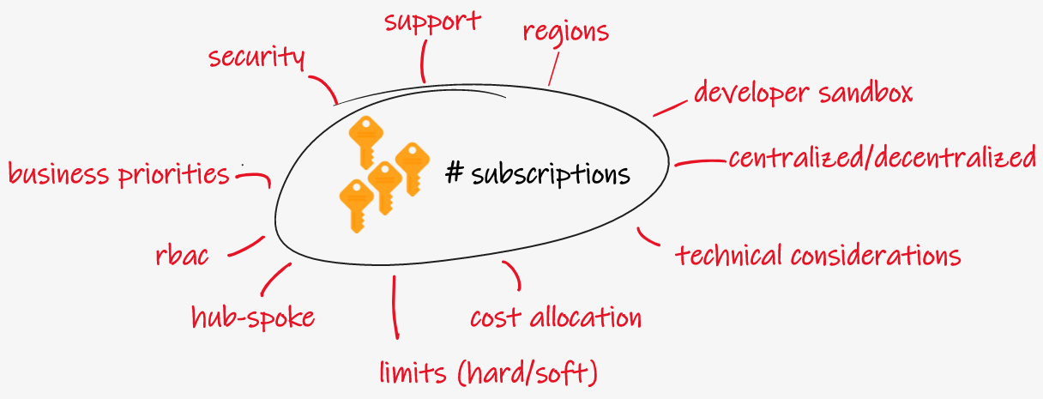
Subscriptions –whiteboard and discussion (notes)
Notes:
How will you decide how many subscriptions your organization needs?
https://learn.microsoft.com/azure/cloud-adoption-framework/ready/azure-best-practices/scale-subscriptions
Will you use a centralized or decentralized approach to subscriptions?
https://learn.microsoft.com/azure/cloud-adoption-framework/manage/centralize-operations

Slide 18


Designing for multiple subscriptions
Azure subscription are logical containers for management and billing.
Align your subscriptions with business needs and priorities – consider billing and cost reporting
Consider subscription scale limits – specialized workloads, IoT, SAP
Consider administrative management – centralized or decentralized
Consider a dedicated shared services subscription – common services everyone shares
Group subscriptions together under management groups – apply common policies and role assignments.
Make subscription owners aware of their roles and responsibilities
Notes:
Subscription decision guide
https://learn.microsoft.com/azure/cloud-adoption-framework/decision-guides/subscriptions/
There next slide provides an example.

Slide 19
When to use subscriptions - example
Secure workloads that require additional policies and role-based access control to achieve compliance
Specialized workloads and the need to scale outside the subscription limits
Manage and track costs for your organizational structure
Identify different environments such as development, test, and production that are often isolated from a management perspective
Tenant root group
Tailwinds
Corporate
IT
HR
Legal
Production
R&D
App1
App2
Shared
Notes:
You may want to bring up that some resources, such as networking, don’t span subscriptions without special configuration. This is a specific example of how subscriptions can help with isolation and management.

Slide 20
Design for resource groups

Slide 21

Plan your resource groups
A resource group is a container that holds related resources for an Azure solution.
Single resource group
Multiple resource groups
RG1
RG1
RG2
RG3
Subscription A
Subscription A
Group resources that share the same life cycle
Group by type, app, department, location, or billing
Apply RBAC and policies to a group of resources
Use resource locks to protect individual resources from deletion or change
Notes:
What is Azure Resource Manager
https://docs.microsoft.com/azure/azure-resource-manager/management/overview

Slide 22
Design for resource tagging

Slide 23

Plan your resource tagging
Resource tagging can be business-aligned or IT-aligned
Consider your organization’s taxonomy
Determine the reason for the tagging - functional, classification, accounting, partnership, or purpose
Start with a few tags (mission-critical resources) and then scale out
Policies could be used to apply tags and enforce tagging rules and conventions - mimic inheritance
Tenant root group
Tailwinds
Corporate
IT
HR
Legal
Production
R&D
Classification: Internal, NDA
App1
App2
Shared
Product: App1, App2, Shared
Notes:
Quick review – do not dwell and teach tags this is a WHY you should use tags.
Resource naming and tagging decision guide - https://learn.microsoft.com/azure/cloud-adoption-framework/decision-guides/resource-tagging/
Define your tagging strategy - https://learn.microsoft.com/azure/cloud-adoption-framework/ready/azure-best-practices/resource-tagging
Resource tagging patterns - https://learn.microsoft.com/azure/cloud-adoption-framework/decision-guides/resource-tagging/?toc=/azure/azure-resource-manager/management/toc.json#resource-tagging-patterns
Discussion questions:
What are specific examples of leveraging tags? (cost reporting, targeting automation scripts, integrating with 3rd party applications, etc.)
Will you implement a chargeback or show back accounting system? Will you need to associate resources with accounting information for departments, business groups, and teams in more detail than a simple subscription-level breakdown allows?
Does tagging need to represent details such regulatory compliance requirements for a resource? What about operational details such as uptime requirements, patching schedules, or security requirements?
What tags will be required for all resources based on centralized IT policy? What tags will be optional? Are individual teams allowed to implement their own custom tagging schemes?

Slide 24
Design for Azure Policy and RBAC

Slide 25

When to use Azure Policy
Azure Policy helps to enforce organizational standards and to assess compliance at-scale.
Virtual machines limited to certain SKUs
Enforce product tag and value
Production
Deploy only in certain locations – different for each app
Enable auditing and logging for SQL apps
App1
App2
Large number of built-in policies and you can create custom policies
Examples
Allow only certain virtual machines sizes for your project
Ensure all resources are correctly tagged – if not, apply the tag
Recommend system updates on your servers
Enable multifactor authentication for all subscription accounts
Notes:
What is Azure Policy
https://learn.microsoft.com/azure/governance/policy/overview
Azure Built-in Policy List
https://learn.microsoft.com/azure/governance/policy/samples/built-in-policies#general
There is a second slide on considerations.

Slide 26
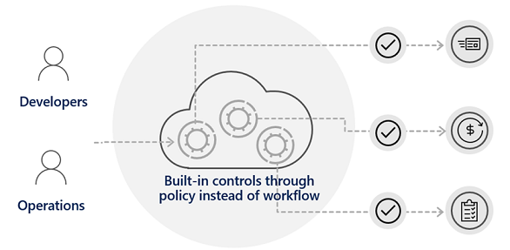
Considerations for Azure Policy
Apply policy at the highest scope possible
Know when policies are evaluated
Decide what to do if a resource is non-compliant
Consider when to automatically remediate non-compliant resources
Use the Azure policy compliance dashboard for auditing and review
Effectively combine Azure policy with RBAC (RBAC on next slide, combination on slide after)

Slide 27
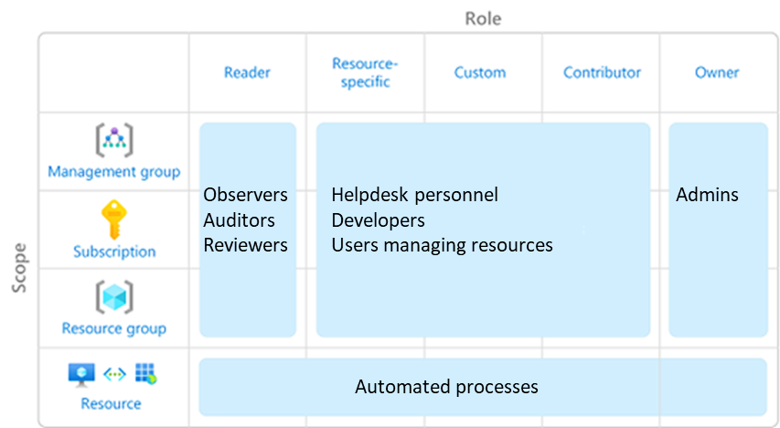
Design for Azure role-based access control (RBAC)
Azure RBAC allows you to grant access to Azure resources that you control.
Only grant users the access they need
Assign at the highest scope level that meets the requirements
Assign roles to groups, not users
Know when to create a custom role
Consider what happens if you have overlapping role assignments
Notes:
Only grant the access users need
https://learn.microsoft.com/azure/role-based-access-control/best-practices#only-grant-the-access-users-need
Limit the number of subscription owners
https://learn.microsoft.com/azure/role-based-access-control/best-practices#limit-the-number-of-subscription-owners
Microsoft Entra Privileged Identity Management
https://learn.microsoft.com/azure/role-based-access-control/best-practices#use-azure-ad-privileged-identity-management
Assign roles to groups, not users
https://learn.microsoft.com/azure/role-based-access-control/best-practices#assign-roles-to-groups-not-users
Discussion: How to allow some users to control the virtual machines in an environment but prevent them from modifying networking and other resources in the same resource group or Azure subscription? Create a role assignment through Azure role-based access control (Azure RBAC). Azure RBAC enables you to create roles that define access permissions. You might create one role that limits access only to virtual machines and a second role that provides administrators with access to everything.

Slide 28



When to combine Azure Policy and Azure RBAC
Deny
Cloud resource
Cloud resource
No
Yes
RBAC
Azure Policy
Deploy cloud resource
Does the Admin have the necessary rights?
Yes
Is a restricting policy defined?
No
Cloud resource
Azure Admin
RBAC examples
Does the Admin have the right to deploy?
Does the Admin have the right to deploy this resource type?
Does the Admin have the right to deploy this resource group?
Policy examples
Is the region restricted?
Is the resource type restricted?
Should a tag be applied?
Notes:
Discussion: How is policy different from RBAC? How do they complement one another?
RBAC examples
Does the Admin have the right to deploy? Contributor or owner.
Does the Admin have the right to deploy this resource type? VM contributor.
Does the Admin have the right to deploy this resource group.
Policy examples
Is the region restricted? US West or Europe.
Is the resource type restricted? Only virtual machines.
Should a tag be applied?

Slide 29
Design for Landing Zones

Slide 30
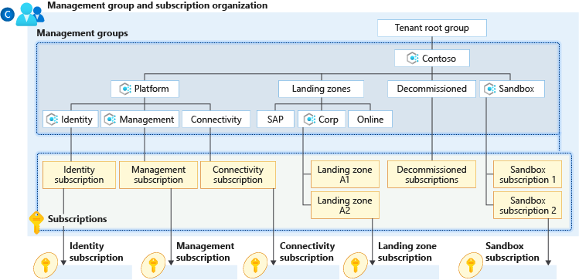
Implement Landing Zones
A landing zone provides an infrastructure environment for hosting your workloads.
Implements key foundational principles of governance, security, networking, management, and identity
Pre-provisions the environment through code
Good for both migrations and green field situations
You can transition existing architectures
Part of the Cloud Adoption Framework Ready phase
Notes:
Use this slide to introduce the concept of landing zones and tie together the governance discussion. Keep the discussion at the introductory level. There are two very good Learn modules to help you decide what to cover. The Introduction module includes the slide diagram.
What are Azure Landing Zones
https://learn.microsoft.com/azure/cloud-adoption-framework/ready/landing-zone/
Choose the best Azure landing zone to support your requirements for cloud operations
https://learn.microsoft.com/learn/modules/cloud-adoption-framework-ready/

Slide 31
Case Studies and Review

Slide 32
Case Study – Cost and accounting
Tailwind Traders has two main business units that handle Apparel, and Sporting Goods.
Each of the business units consist of three departments: Product Development, Marketing, and Sales.
Each business unit and subunit will be responsible for tracking their Azure spend.
The Enterprise IT team will be responsible for providing company-wide Azure cost reporting.
What are different ways Tailwind Traders could organize their subscriptions and management groups. Which would be the best to meet their requirements?
Design two alternative hierarchies and explain your decision-making process.
Notes:
Case study – Cost and Accounting
https://microsoftlearning.github.io/AZ-305-DesigningMicrosoftAzureInfrastructureSolutions/Instructions/CaseStudy/01-Governance.html

Slide 33

Instructor – Cost and accounting
Tenant root group
Tailwinds
Apparel
Sporting Goods
Product Dev
Marketing
Sales
Product Dev
Marketing
Sales
Notes:
Use a whiteboard or this slide to discuss student solutions. Use the icons on the right to show where management groups, subscriptions, resource groups, policies, blueprints, and tags could be applied.

Slide 34
Case study – New development project
The company has a new development project for customer feedback.
The CFO wants to ensure all costs associated with the project are captured.
For the testing phase workloads should be hosted on lower cost virtual machines.
The virtual machines should be named to indicate they are part of the project.
Any instances of non-compliance with resource consistency rules should be automatically identified.
What are the different way Tailwind Traders could track costs for the new development project?
How are you ensuring compliance with the requirements for virtual machine sizing and naming?
Propose at least two ways of meeting the requirements. Explain your final decision.
Notes:
There is no separate Instructor slide for this case study. Use the Instructor solution to discuss how tagging, policy, subscriptions, or resource groups could be used.
https://microsoftlearning.github.io/AZ-305-DesigningMicrosoftAzureInfrastructureSolutions/Instructions/CaseStudy/01-Governance.html

Slide 35
Learning Recap – Governance solutions
Control and organize Azure resources with Azure Resource Manager
Describe core Azure architectural components
Build a cloud governance strategy on Azure
Introduction to the Microsoft Azure Well-Architected Framework
Notes:
Additional questions are available in Microsoft Forms –
AZ-305 Design a governance solution (Module 01) - https://forms.office.com/Pages/ShareFormPage.aspx?id=v4j5cvGGr0GRqy180BHbR5NEFZBpuAZBgxPOGXi_gX5UMjBBSElNWTZPTlpRWFZON05LWVBHNVBLSy4u&sharetoken=KocgBG0I1xV4QzU3W1pC&wdLOR=c7339833F-D8F4-4085-BD77-D2FF96DBB871
Learn more with self-paced training
Control and organize Azure resources with Azure Resource Manager
https://learn.microsoft.com/training/modules/control-and-organize-with-azure-resource-manager/
Describe core Azure architectural components - Learn | Microsoft Docs https://learn.microsoft.com/learn/modules/azure-architecture-fundamentals/
Build a cloud governance strategy on Azure - Learn | Microsoft Docs - https://learn.microsoft.com/learn/modules/build-cloud-governance-strategy-azure/
Introduction to the Microsoft Azure Well Architected Framework
https://learn.microsoft.com/training/modules/azure-well-architected-introduction/

Slide 36
End of presentation

